Slide 1
Cloud Firewall Enabling secure local internet breakouts
Notes:
Thanks and confirm time

Slide 2










Three architectures to secure local breakouts
Local Breakouts
UTMs / NGFW Appliances
Local Breakouts Virtual NGFWs
Local Breakouts
Cloud Security Platform
PRIVATE CLOUD
PRIVATE CLOUD
PRIVATE CLOUD
Branches
Branches
Branches
Poor security
Cost to buy and deploy
Management nightmare
Poor security and scale
Poor user experience (backhaul)
Large attack surface
Unmatched protection all locations
Fast and direct user experience
Zero Attack Surface
Purpose-built cloud security platform is the best way to secure local breakouts
Aligns with Gartner’s recommended SASE architecture – thin branch / heavy cloud

Slide 3
Zscaler Cloud Firewall
More than a next-generation firewall, without the cost and complexity
Secures local breakouts
Identical protection everywhere
Enables secure local internet breakouts and delivers security and access controls for all ports and all protocols without appliances
Brings the entire security stack close to the user, ensuring identical protection for users on any device from wherever they connect
Elastic scale
Real-time visibility and control
Scales elastically by user, to handle SSL inspection and cloud app traffic requiring long-lived connections for a fast user experience
Logs every session in detail to deliver real-time visibility across all users, all locations, all devices, all applications, all ports and all protocols

Slide 4
Zscaler Cloud Firewall
More than a next-generation firewall
SaaS
Open Internet
Proxy-based architecture
Dynamically inspects traffic for all users, apps, devices, and locations
Natively inspects SSL/TLS traffic—at scale
Enables granular firewall policies based on network/app, domain name (FQDN), and URL
DNS security and control
Protects users from reaching malicious domains
Optimizes DNS resolution to deliver better user experience and cloud app performance (critical for CDN-based apps)
Provides granular controls to detect and prevent DNS tunneling
Cloud IPS
Delivers always-on IPS threat protection, regardless of connection type or location
Inspects all user traffic on and off network, even SSL
Restores full visibility into user, app, and internet connections
Visibility and simplified management
Real-time visibility, control, and immediate policy enforcement
Logs every session in detail
Uses advanced analytics to correlate events and provide insights
Branch
HQ
Road Warrior
Your Workforce

Slide 5
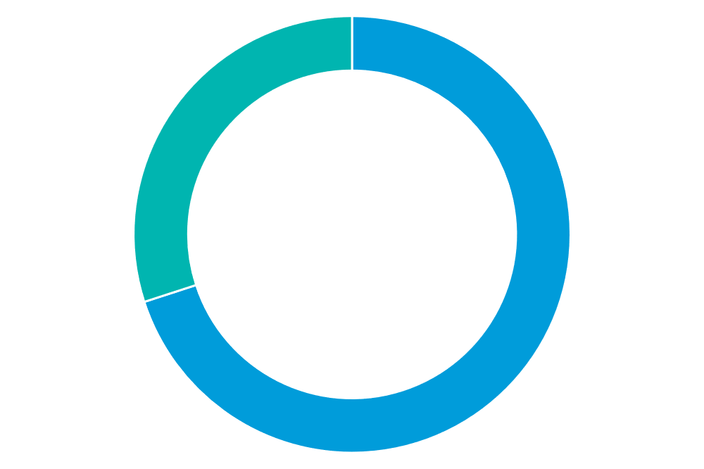








Purpose-built proxy-based architecture
SaaS
Open Internet
70%
of all web traffic on the Zscaler cloud is SSL encrypted – an increase of 10% over the last six months.
Dynamically inspects traffic for all users, applications, and locations
Natively intercepts and inspects SSL/TLS traffic–at scale–to detect malware hidden in encrypted traffic
Enables granular firewall policies based upon user, location, application
HQ
BRANCH
MOBILE
IOT

Slide 6





DNS security & control
Zscaler Cloud Firewall provides DNS as a service
Protects users from reaching malicious domains as the first line of defense
Granular DNS policies based on user, app, and resolved country
DNS tunnel detection using machine learning
DNS insights provide granular visibility
TLD/Root/Auth DNS Server
www.malicious.com
DNS response
DNS request
DNS Server
Port 53
User
Notes:
Animation Script:
1. When User tries to connect to any bad/malicious domain, all DNS request go through Zscaler DNS server located at each Datacenter.
Bullet points
1. Zscaler will resolve the DNS query and inspect if it belongs to malicious domains and blocks response.
2. Zscaler CFW detects any malicious DNS tunnels and blocks using ML techniques.
3. CFW provides granular policies based on user, app and resolved IP country
4. DNS insights for troubleshooting, correlation etc.

Slide 7




Minimize latency with local DNS
Guarantee a fast, local connection regardless of location
Zscaler Local DNS Architecture
San Jose user > San Jose DNS > San Jose O365
Shortest path, fewer hops = faster user experience
Latency: 12ms
Local DNS
O365 Connection
San Jose RTT=12 ms
Denver RTT=36 ms
Centralized DNS
O365 Connection
Los Angeles RTT=22 ms
Common Centralized DNS Architecture
San Jose user > LA > Denver > Austin > Atlanta O365
Lots of hops = slower user experience
Latency: 52ms
Atlanta RTT=52 ms
Austin RTT=48 ms
Securing your cloud transformation

Slide 8
Cloud IPS
SaaS
Open Internet
User Centric
Protect users from intrusion based on attack signatures, protects against both known and unknown exploits
Always-on Protection
Inline inspection of user traffic on and off network, even hard-to-inspect SSL, regardless of user connection type or location
Real-time, granular control and visibility
Globally unified administration, policy management, and reporting restores full visibility and control into user, app, and internet connections
SNORT signatures
SNORT based signatures for detecting C2C exploits on web and non-web traffic
Notes:
Most IPS solutions are designed to protect both servers and users.
Deliver always-on IPS to all your users
Cloud delivery lets you puts IPS threat protection where traditional IPS can’t go. Zscaler Cloud IPS follows all your users, no matter the connection type or location, and you get the always-on threat protection and visibility you need.
Get protection built for today’s breaches
Zscaler Cloud IPS works across a full suite of technologies like firewall, sandbox, CASB, and DLP to stop more kinds of attacks. You get complete threat protection from botnets, advanced threats, and zero-days, along with contextual information about the user, app, and threat.
Never run out of inspection capacity
Because Zscaler Cloud IPS is delivered as a service, your inspection demands scale automatically and you never run out of capacity. Best of all, you can finally inspect all your SSL traffic and stop more threats where they hide. Say goodbye to the hardware refresh
Always ON IPS Threat protection - Most IPS solutions reside in the data center and lack the ability to deliver visibility and control to off-network traffic. These IPS solutions lose more visibility and control every day, as mobility and SaaS take users and apps off the network. In addition, newer connections—such as SD-WAN, 5G, and direct-to-internet—all encourage organizations to embrace the internet as their corporate network. All these technological shifts have diminished the value of traditional IPS and hindered its ability keep users safe. Zscaler Cloud IPS delivers IPS from the cloud, which allows IPS to follow the user, regardless of connection type or location. Every time a user connects to the internet or an app, Zscaler Cloud IPS is there. It sits between the connection, providing needed IPS threat visibility that traditional IPS solutions have lost. Organizations can finally restore their lost visibility and threat protection.
Because Zscaler Cloud IPS is delivered from the Zscaler Cloud Security Platform, inspection is elastically scaled based upon demand. Every user gets unlimited inspection capacity, so you never have to guess how much inspection you’ll need going forward. Best of all, SSL inspection is native in the Zscaler cloud, so you have the freedom to inspect all your encrypted traffic. No more security compromises, and no more hardware refreshes!
To reduce risk, you need to understand the meaning of your alert data. Key to this task is bringing in full user and application context from external sources and correlating this data. However, many IPS solutions struggle to deliver. The reason? The meaningful context and correlation of threat data requires thoughtful integration of all your security systems. With most solutions, this means “some assembly required,” and, in practice, organizations often find themselves with a full blown science experiment as they try to get disparate systems to work together. With Zscaler Cloud IPS, you get a fully integrated platform from day one, with no assembly required

Slide 9
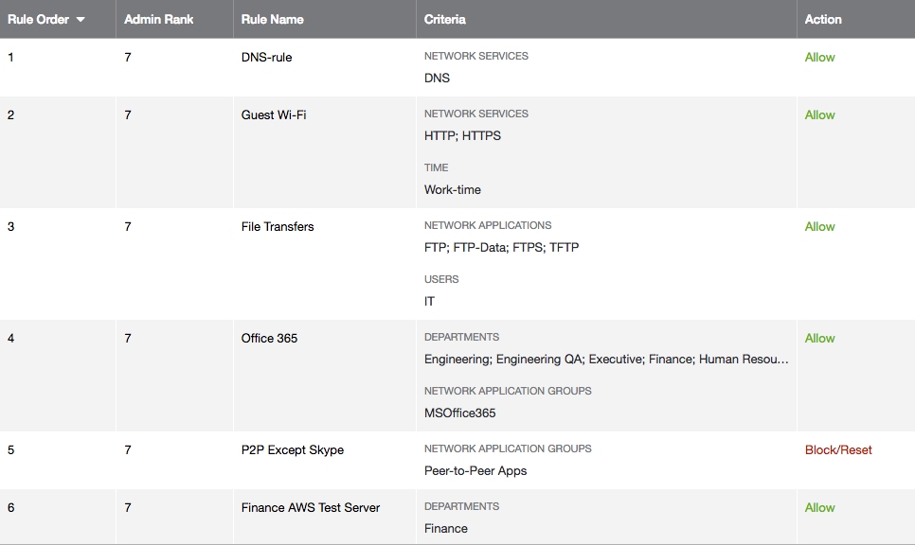
Granular policy control
Define and immediately enforce all policies for all users, devices, and locations
HTTP/HTTPS traffic only on guest Wi-Fi
Allow FTP for IT users only
Block all P2P apps except Skype for Bus
Allow access to dynamic IPs based upon FQDN

Slide 10
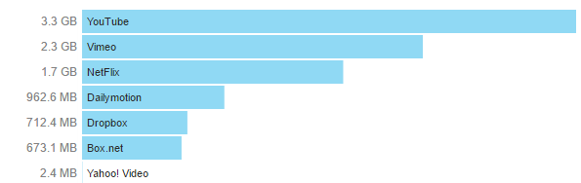
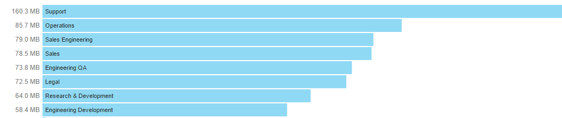
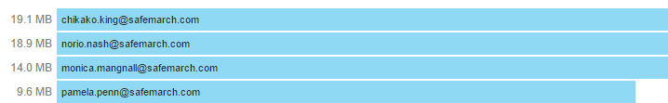
Global real-time visibility and control
Uses advanced analytics to correlate events and provide insights
Do you have a corporate cloud storage?
Have departments procured cloud applications without IT consent?
Drill down into application usage per user

Slide 11







Policy follows the user
Same policy applies when user is in branch or remote/traveling
Traditional Approach Challenges
External Apps
Internal Apps
Cloud Firewall Benefits
VPN remote user traffic
Separate policy & appliance
Backhauling traffic
Operational complexity
No visibility on user behavior
Consistent policy
Cost saving (no VPN)
Security stack follows user
Improved user exp
Global visibility and control
Separate Policy and Appliance
Same Policy
Broadband
4/5G
Branch
Road Warrior
User moves
User moves
https://
Skype
SSH
https://
Skype
SSH

Slide 12
Zscaler Cloud Firewall for Office 365 and Internet Content + SaaS
Leverage local internet breakout for all Internet + SaaS Apps
For your Office 365 Traffic
Zscaler
For your Open Internet traffic
Microsoft Office 365’s Networking Partner Program
A full NGFW and more for the rest
of your direct internet connections
(any other SaaS and content destination)
Microsoft Office 365: meets Office 365 Networking Partner Program
Easily deployed. No hardware needed!
One Click configuration automates O365 IP address changes and exempts from SSL inspection
Optimize connectivity with Zscaler Cloud Firewall and Bandwidth Control
DNS Security
Cloud IPS
Identical Protection
Global Visibility
Zscaler Cloud Firewall

Slide 13

$21.3 billion
revenue
26,000+
employees
360+
locations
America’s Largest Auto Retailer
Challenge
Secure retail locations and provide fast internet access
Costs of backhauling traffic to centralized data center
Deploy Office 365 and establish e-commerce presence
“
We’ve greatly simplified our architecture by eliminating the cost and complexity of appliances…
Solution
Local breakouts and full application and network transformation
Outcome
Cost avoidance - local breakouts without appliances
Centralized policy management and visibility into all traffic
Simplified IT operations
Ability to easily add new locations and capabilities

Slide 14
Thank you!
ZSCALER CONFIDENTIAL INFORMATION

Slide 15



What about non-web applications?
Only breakout HTTP
UDP > Atlanta > San Jose
User traffic is routed back from Atlanta to San Jose instance
Lots of hops leads to slow experience and split logs
UDP video stream
Multiple hops
Full local breakout
UDP > San Jose
UDP video stream
User traffic is directly routed to San Jose instance for all traffic
Single point for access control and visibility

Slide 16
Did you know?
Standard Cloud Firewall
is integrated into the
Secure Internet Platform
With it you get
Unified policy (5 tuple by location)
Single console (dashboard)
One set of logs (blocked sessions)
For ALL your outbound traffic

Slide 17
Firewall package features
Feature | Standard FW | NG FW
Network Service ( 5 tuple Policy) |  | 
Network Application Awareness (DPI Engine) | ✘ | 
User Awareness | ✘ | 
FQDN Based Policy | ✘ | 
DNS control | ✘ | 
FTP control | FTP Network Service ( Native FTP ONLY) | 
NAT Control |  | 
Analytics: Firewall, DNS Insights | ✘ | 
Dashboard: Firewall | ONLY for Block rule (Firewall) | 
Dashboard: DNS | ✘ | 
Full & Hourly Logging on all rules | Need Additional License | 
Standard Firewall – is integrated into the Secure Internet Platform (SIP)
Next-Gen Firewall – Separate Stand-alone SKU that includes Full Logging (ZFW-NG-WITH-LOG)
Full Logging License – Can be purchased with Basic FW ( ZFW-STD-LOG)
Z-LOGFEED – will provide NSS Live logs to SIEM for both Web and Firewall
Z-LOGFEED-FW-MGMT – is an optional SKU if 1 hour recovery is required for Firewall

